Slide 1
The Heart of the Matter
Structure and Function of the Heart
By: Dr. Varun Ahuja
MPSVV, Ujjain

Slide 2

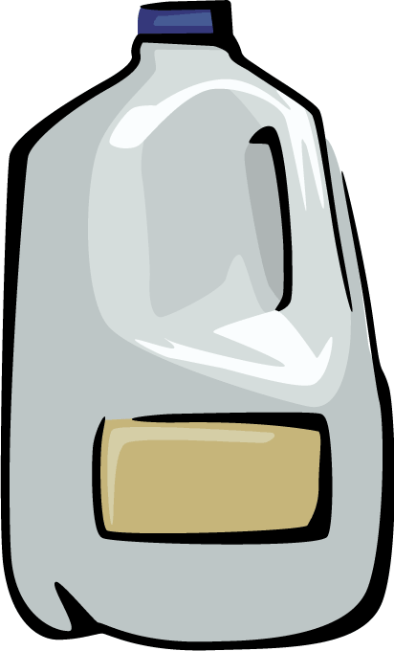
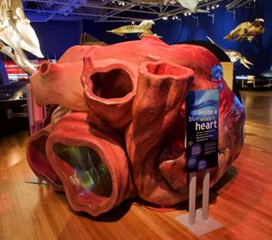

5 Interesting Facts about the Heart
Each day, your heart beats 100,000 times.
Each minute, your heart pumps 1.5 gallons of blood.
Heart disease is the #1 cause of death.
A normal heart valve is about the size of a half dollar coin.
The largest heart ever recorded belonged to a grey whale.
Notes:
http://health.clevelandclinic.org/2013/07/19-amazing-facts-about-your-heart-infographic/
http://www.bu.edu/today/2010/a-whale-of-an-exhibition/
http://www.culinaryschools.org/clipart/drinks/

Slide 3
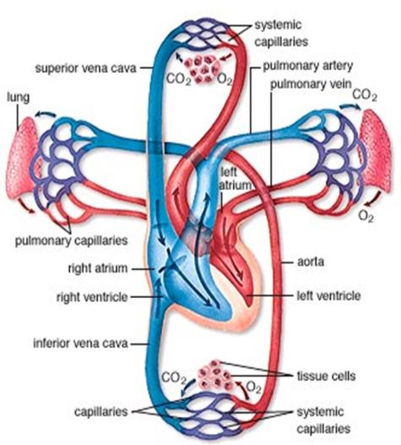
Functions of the Heart
Pumps oxygenated and nutrient-rich blood to the body through blood vessels
Pumps deoxygenated blood, containing wastes, to the lungs, where gas exchange to the outside environment occurs
Notes:
http://www.mhhe.com/biosci/esp/2001_gbio/folder_structure/an/m7/s3/

Slide 4
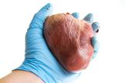
Anatomy of the Heart
Located under rib cage and in between the lungs
Size varies depending on age, size, and condition of the heart
On average, the heart is about the size of that person’s clenched fist
Notes:
http://www.livescience.com/34655-human-heart.html

Slide 5
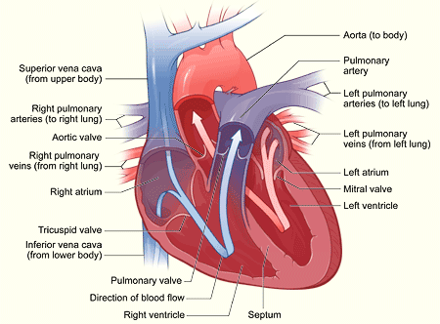
Four Chambers of the Heart
Right Atrium
Right Ventricle
Left Atrium
Left Ventricle
Notes:
http://gal1.piclab.us/key/blood%20flow%20through%20the%20heart%20step%20by%20step

Slide 6
Atria
Septum
The upper two chambers of the heart
Receive and collect blood
Muscle that divides the heart into right and left halves
Ventricles
The lower two chambers of the heart
Pump blood out of the heart

Slide 7
Valves
4 Heart Valves
  Tricuspid Valve
  Pulmonary Semilunar Valve
  Mitral (Biscuspid) Valve
  Aortic (Semilunar) Valve
Purpose: prevent backflow of blood, keep blood flowing in one direction

Slide 8
Flow of Blood
1. Deoxygenated blood from the upper and lower body flows through the superior and inferior vena cava.

Slide 9
Flow of Blood
2. The superior and inferior vena cava empty blood into the right atrium.

Slide 10
Flow of Blood
3. Blood from the right atrium passes through the tricuspid valve.

Slide 11
Flow of Blood
4. Blood passes through the tricuspid valve into the right ventricle.

Slide 12
Flow of Blood
5. Blood from the right ventricle passes through the pulmonary semilunar valve.

Slide 13
Flow of Blood
6. Blood flows through the pulmonary semilunar valve into the right and left pulmonary arteries.

Slide 14

Flow of Blood
7. Pulmonary arteries take blood to the lungs for gas exchange.
In the lung capillaries, blood picks up oxygen and transfers carbon dioxide to the lungs for exhalation.
Blood becomes oxygenated.
Notes:
http://www.mhhe.com/biosci/esp/2001_gbio/folder_structure/an/m7/s3/

Slide 15
Flow of Blood
8. Right and left pulmonary veins bring the blood back to the heart.

Slide 16
Flow of Blood
9. Pulmonary veins empty blood into the left atrium.

Slide 17
Flow of Blood
10. The blood from the left atrium flows through the mitral (or bicuspid) valve.

Slide 18
Flow of Blood
11. After passing through the mitral valve, blood enters the left ventricle.

Slide 19
Flow of Blood
12. Blood from the left ventricle passes through the aortic semilunar valve.

Slide 20
Flow of Blood
13. After passing through the aortic semilunar valve, the blood enters the aorta and is then pumped to the rest of the body.

Slide 21
Circulation
Pulmonary circuit: movement of blood from the heart to the lungs and back to the heart

Slide 22
Circulation
Systemic circulation: movement of blood from the body to the heart and back to the body
Why do you think the left side of the heart is larger than the right?
Answer: Because the left side has to pump blood further!
Notes:
See if students can answer this question about why the left side of the heart is larger. The left side of the heart is responsible for pumping blood to the body (from head to toe). This covers a much larger distance than to just the lungs, which is what the right side is responsible for.

Slide 23
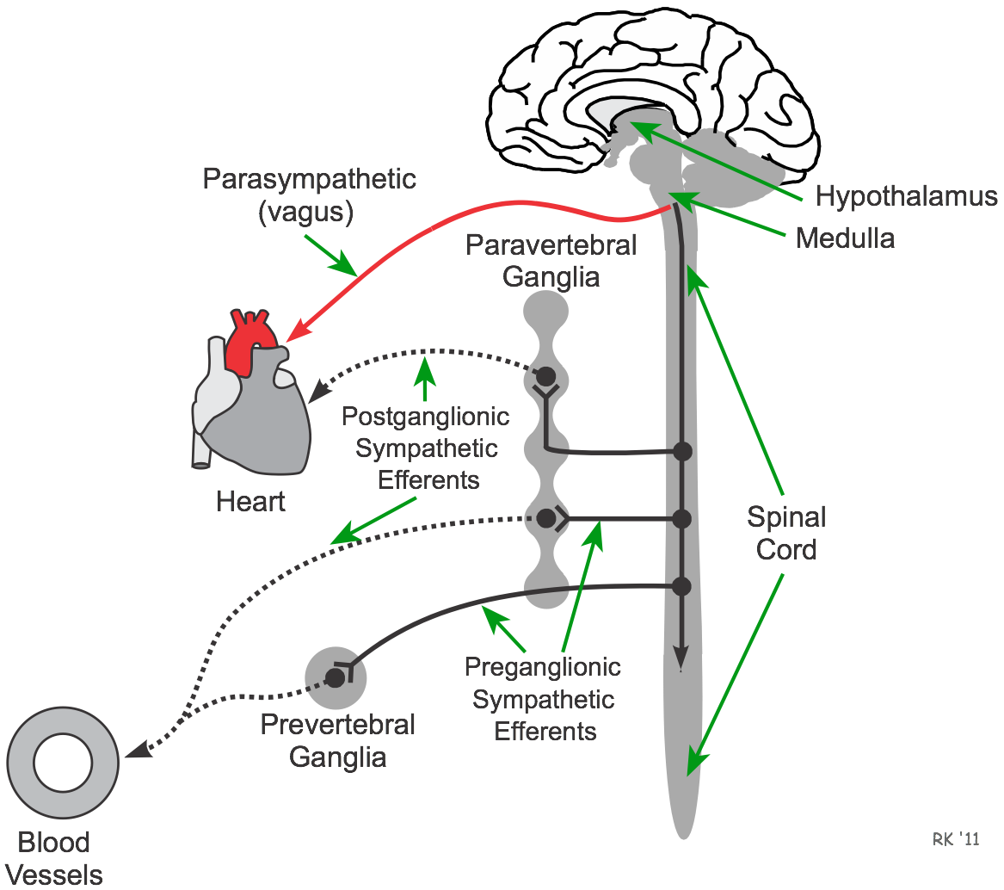
Sympathetic and Parasympathetic Activities
Parasympathetic activities are controlled by branches of Vagus Nerve.
Preganglionic Sympathetic
Nerves control Sympathetic
Activities.

Slide 24
Contraction (Cardiac Cycle) 0.8 sec
Systole - contract
  Atrial Systole: when the atria contract and pump blood into the ventricles (0.1 sec)
  Ventricular Systole: when the ventricles contract and pump blood out of the heart to the lungs or body (0.3 sec)
Diastole - relax
  When the atria and ventricles relax and start to fill with blood

Slide 25
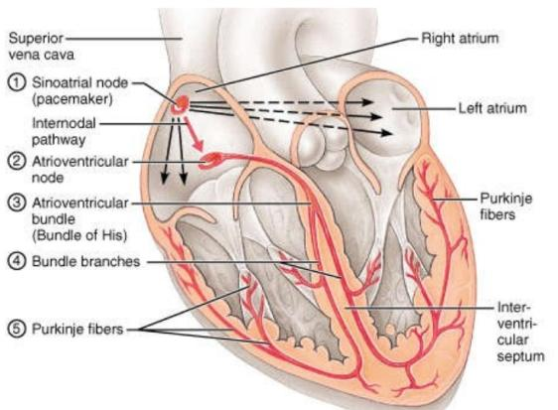
Electrical System
AKA the Cardiac Conduction System
Consists of three parts:
  1. Sinoatrial (SA) node
  2. Atrioventricular (AV) node
  3. Bundle of His and Purkinje fibers
Notes:
http://www.slideshare.net/Firedemon13/cardiac-conduction-system-8164970

Slide 26
Electrical System
1. Electrical signal starts at the SA node as blood fills the right atrium.
  This signal causes the atrium to contract.
  The SA node sets the pace of the heart, so it is also called the pacemaker.
2. Signal arrives at the AV node as blood fills the ventricles.
3. Signal moves along the Bundle of His and along the walls of the ventricles.
  The Bundle of His divides into right and left branches and then to Purkinje fibers.
  The ventricles contract.
4. Signal passes and ventricles relax.

Slide 27
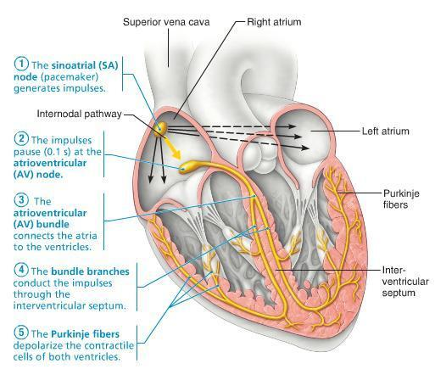
Electrical System
Notes:
http://ryody001.tistory.com/category/Homeostatic%20Imbalances%20and%20Diseases/Cardiovascular%20System

Slide 28
Examples of Heart Diseases/Conditions
Congestive Heart Failure
  The heart is too weak or stiff to pump blood effectively.
Myocardial Infarction (Heart attack!)
  The coronary artery is blocked so blood cannot supply the heart with oxygen, and heart muscle dies.
Atrial Fibrillation
  Abnormal electrical impulses in the atrium cause irregular heart beat.

Slide 29
Blood Circulation
Aorta
Arteries
Arterioles
Capillaries
Venules
Veins
Venacava

Slide 30
Factors Maintaining Blood Pressure
Cardiac Output
Blood Volume
Viscosity of Blood
Elasticity of atrial walls
  When atries loose their elasticity its called Atheroma Disease.

Slide 31
References
http://www.nhlbi.nih.gov/health/health-topics/topics/hhw/
http://www.webmd.com/heart/picture-of-the-heart
http://www.mayoclinic.org/diseases-conditions/heart-disease/in-depth/heart-disease-prevention/art-20046502
http://health.clevelandclinic.org/2013/07/19-amazing-facts-about-your-heart-infographic/

