Slide 1
BLOOD
PHYSIOLOGY
By: Dr. Varun Ahuja

Slide 2
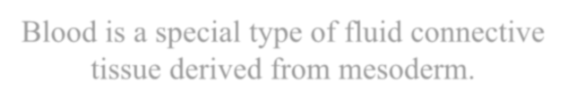
BLOOD
Blood is a special type of fluid connective tissue derived from mesoderm.
The branch of science concerned with the study of blood, blood-forming tissues, and the disorders associated with them is called haematology.
(Gk: haeme – blood and logos - study) 7% of Body Weight

Slide 3
PROPERTIES OF BLOOD
Colour | Bright red in arteries & dark red in veins
pH | Slightly alkaline (pH = 7.35 – 7.45)
Taste | Salty
Temperature | 38° C (100.4° F)
Viscosity | 3 – 4 times more viscous than water
Volume | 5 – 6 litre

Slide 4

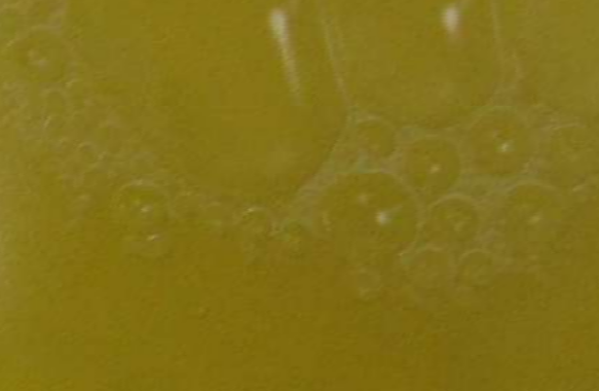
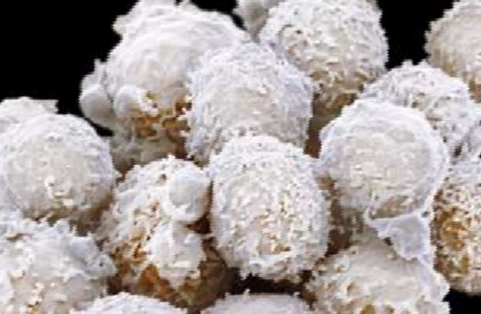





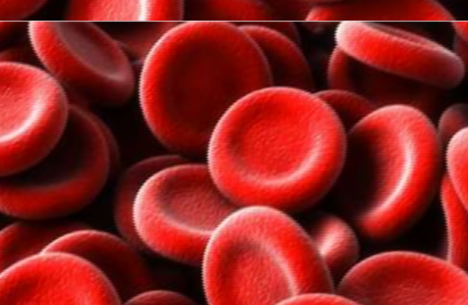
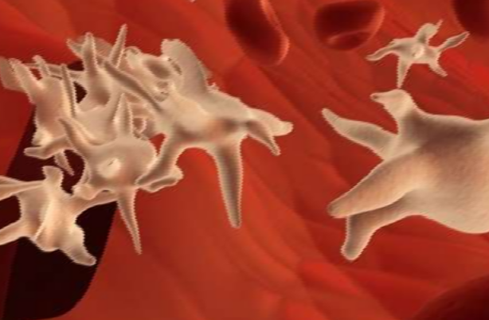




COMPOSITION OF BLOOD
Plasma
White blood cells
Centrifuged blood
Red blood cells
Platelets

Slide 5



Blood
Plasma (55%)
Cellular elements (45%)
RBCs
(erythrocytes)
WBCs
(leucocytes)
Platelets (thrombocytes)

Slide 6
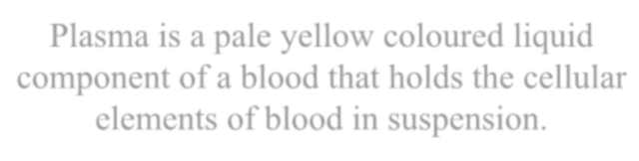
Plasma
Plasma is a pale yellow coloured liquid component of a blood that holds the cellular elements of blood in suspension.
(Bilirubin)

Slide 7

















Constituents of plasma
Water
(91.5%)
Albumins
Proteins (7%)
Electrolytic ions
(Na⁺, K⁺, Ca²⁺, Mg²⁺, Cl⁻, HCO₃⁻, SO₄²⁻)
Globulins
Gases
(O₂, CO₂, N₂)
Plasma
Fibrinogen
Nutrients
(Glucose, amino acids, fatty acids)
Other solutes (1.5%)
Waste products
(Urea, uric acid, amonia, creatinine)

Slide 8
Functions of plasma
Constituent | Function
Water | Absorbs, transports and releases heat
Globulins | Defense mechanism
Fibrinogen | Blood clotting
Electrolytic ions | pH buffering

Slide 9

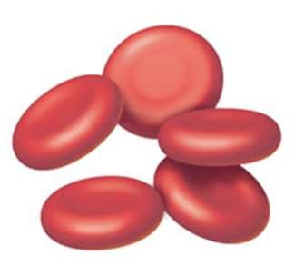
Red blood cells
Colour | Red (haemoglobin pigment)
Count | 4.5 to 5.5 million RBCs/100ml
Life span | 120 days
No Nucleus Present in RBC’s

Slide 10

Erythropoiesis
The production of RBCs is known as erythropoiesis.
Adult | Red bone marrow of long bones (hip bone, breast bone & ribs)
Child (upto 5 year) | Bone marrow of all the bones
Foetus | Liver & spleen
Increase in number of RBCs is known as polycythemia
Decrease in number of RBCs is known as erythropenia/Anemia
Decrease in Life Span of RBC’s- Thalassemia

Slide 11
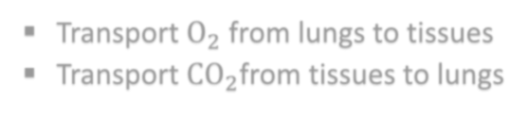






Functions of RBCs
Transport O₂ from lungs to tissues
Transport CO₂from tissues to lungs
Normal blood contains 13 – 15 g of Hb per 100 ml of blood
One RBC contains about 250 million molecules of Hb
Each molecule of Hb carries four molecules of oxygen

Slide 12

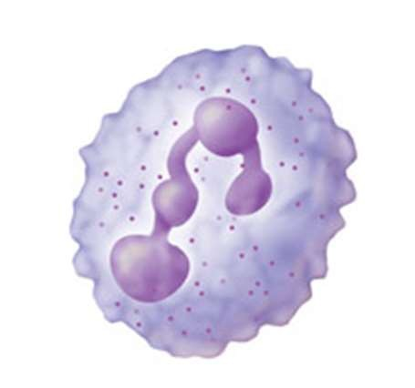
White blood cells
Colour | Colourless & translucent
Count | 5000 – 10000 WBCs/100ml
Life span | 10 – 13 days

Slide 13

Leucopoiesis
The production of WBCs is known as leucopoiesis.
Adult | Liver, spleen, tonsils, bone marrow
Foetus | Liver, spleen
Increase in number of WBCs is known as leucocytosis
Decrease in number of WBCs is known as leucopenia
Pathological increase in number of WBCs is known as leukemia (blood cancer)

Slide 14




Types of WBCs
WBCs
Granular
Agranular
Neutrophils (62%)
Acidophils (2.3%)
Basophils (0.4%)
Lymphocytes (30%)
Monocytes (5.3%)

Slide 15
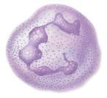
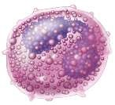
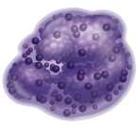
Granular WBCs
Location produced
Type
Appearance Features
Nucleus with 3-4 lobes
Stain with neutral dye (hematoxylin)
Neutrophils
Maximum
Phagocyte (Bacteria)
Bone marrow
Fight against Virus
Acidophils (eosinophils)
------
Bone marrow
Nucleus with indistinct lobes
Stain with basic dye
(methylene blue)
Minimum
Fights Allergy
Basophils
Bone marrow

Slide 16

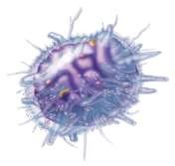
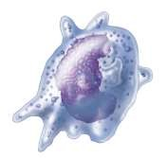
Agranular WBCs
Location produced
Type
Appearance Features Functions
Smallest of WBCs
Bone marrow, spleen, tonsils
Produce antibodies
Lymphocyte
Largest of WBCs
-----------
Monocyte
Bone marrow

Slide 17
Ratio
RBC: WBC: Platelets
600:1:40
4.5 Lacs: 8,000: 1.5lacs

Slide 18

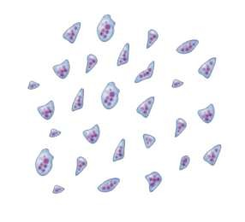
Platelets
Count | 1,50,000 – 4,00,000 platelets/100ml
Life span | 5 – 9 days
Function | Blood clotting

Slide 19
Thrombopoiesis
The production of platelets is known as thrombopoiesis.
Platelets are the fragments of large cells called megakaryocytes that remain in the bone marrow.
Increase in number of platelets is known as thrombocytosis
Decrease in number of platelets is known as thrombocytopenia

Slide 20
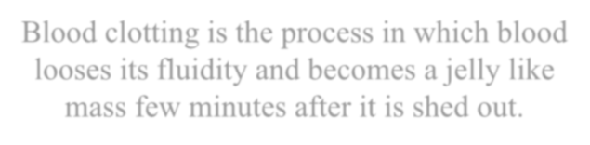
Blood clotting
Blood clotting is the process in which blood looses its fluidity and becomes a jelly like mass few minutes after it is shed out.

Slide 21
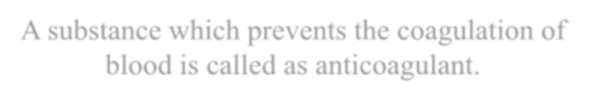
Anticoagulant
A substance which prevents the coagulation of blood is called as anticoagulant.
Heparin is a natural anticoagulant present in the blood.
If blood clots too easily, the result can be thrombosis – clotting in an undamaged blood vessel.
If the blood takes too long to clot, haemorrhage can occur.

Slide 22
Blood Clotting
Mineral- Calcium (ca)
Vitamin- Vitamin K
Protein- Fibrinogen
Blood Cells- Platelets

Slide 23
ABO Blood Group System
Antigens are found at the outer surface of RBC’s which decides the type of blood group
Antigen A
Antigen B
Blood Plasma contains antibody for other Example- A antigen (Blood) has B Antibody
Antigen- agglutinogen(Glycoprotein)
Antibody- Agglutinins

Slide 24
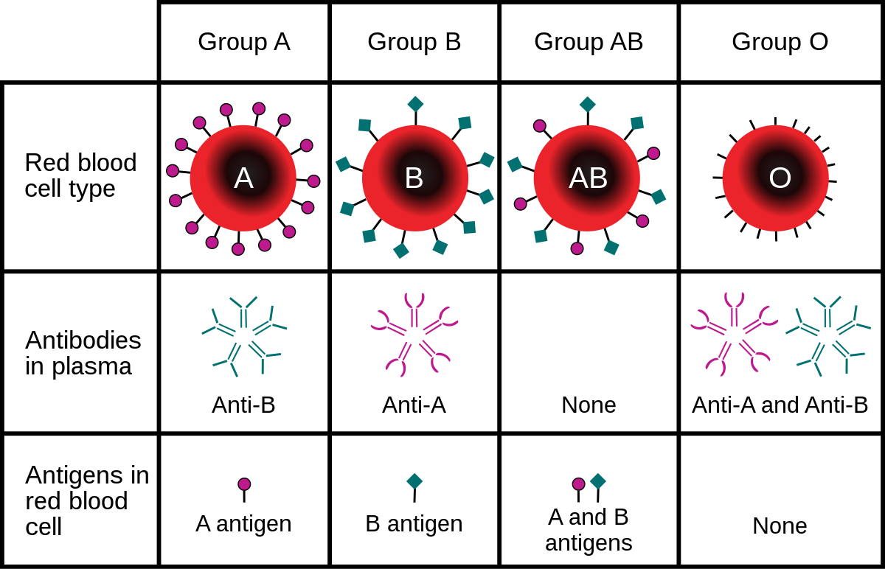

Slide 25
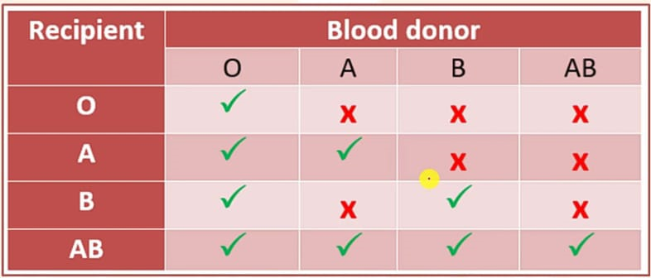

Slide 26
Rhesus Factor- Blood Group
Karl Landsteiner founded blood groups in humans in 1901 and Rh factor in blood by testing a monkey named Rhesus in 1940.
Rh factor is found in 85% of humans (+) and the remaining 15% don’t have Rh factor (-)

Slide 27
